Slide 1
AWS

Slide 2


Slide 3
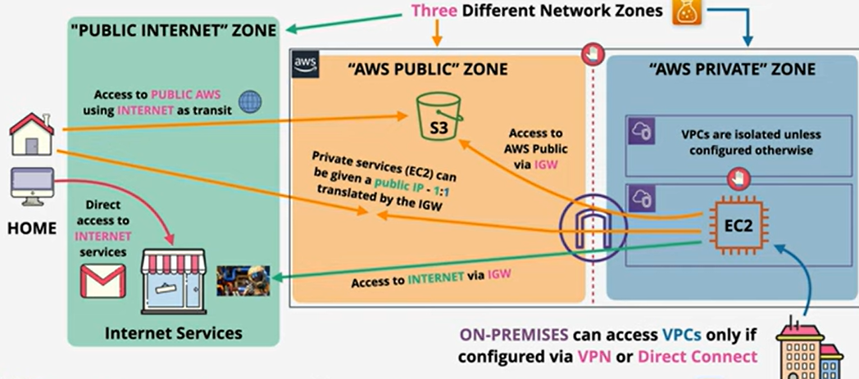

Slide 4
Global infrastructure
The AWS Cloud infrastructure is built around AWS Regions and Availability Zones.
An AWS Region is a physical location in the world where we have multiple Availability Zones.
Availability Zones consist of one or more discrete data centers, each with redundant power, networking, and connectivity, housed in separate facilities.
These Availability Zones offer you the ability to operate production applications and databases that are more highly available, fault tolerant, and scalable than would be possible from a single data center.
For the latest information on the AWS Cloud Availability Zones and AWS Regions

Slide 5
The components are:
Availability Zones (AZs)
Regions
Edge Locations
Regional Edge Caches

Slide 6
AWS Global Infrastructure: Availability Zones
AZs are essentially the physical data centers of AWS. This is where the actual compute, storage, network, and database resources are hosted that we as consumers provision within our Virtual Private Clouds (VPCs). A common misconception is that a single availability zone is equal to a single data center. This is not the case. In fact, it’s likely that multiple data centers located close together form a single availability zone.
Each AZ will always have at least one other AZ that is geographically located within the same area, usually a city, linked by highly resilient and very low latency private fiber optic connections. However, each AZ will be isolated from the others using separate power and network connectivity that minimizes impact to other AZs should a single AZ fail.

Slide 7
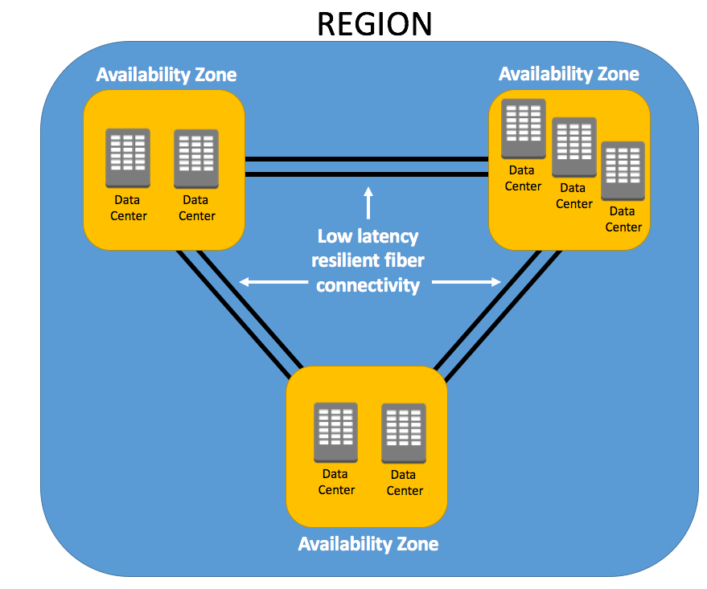

Slide 8
Global and Regional AWS architecture
Global Service Location and Discovery
Content Delivery(CDN) and Optimizations
Global Health Check and failover
Regional entry point
Scaling and resilience
Application services and Components

Slide 9
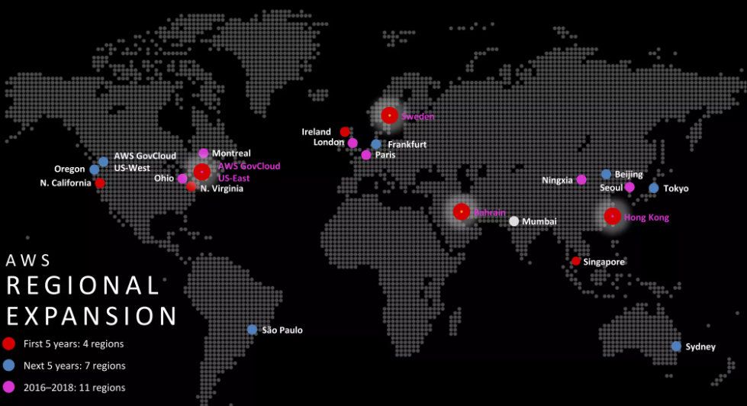

Slide 10
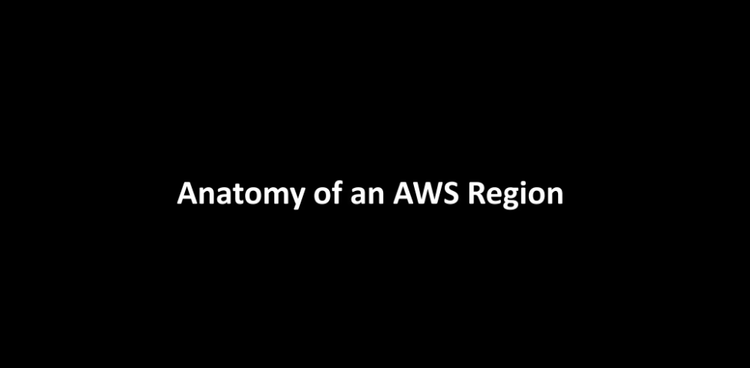

Slide 11
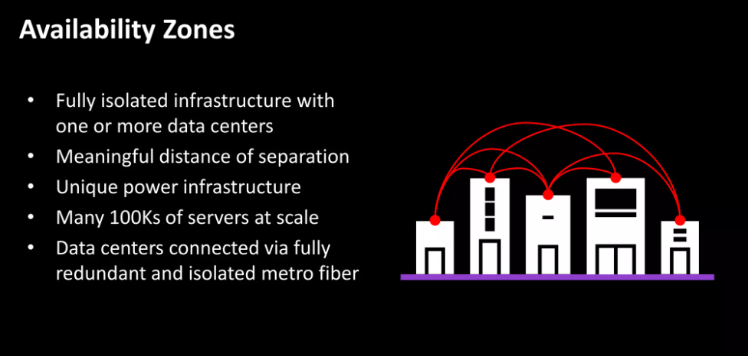

Slide 12
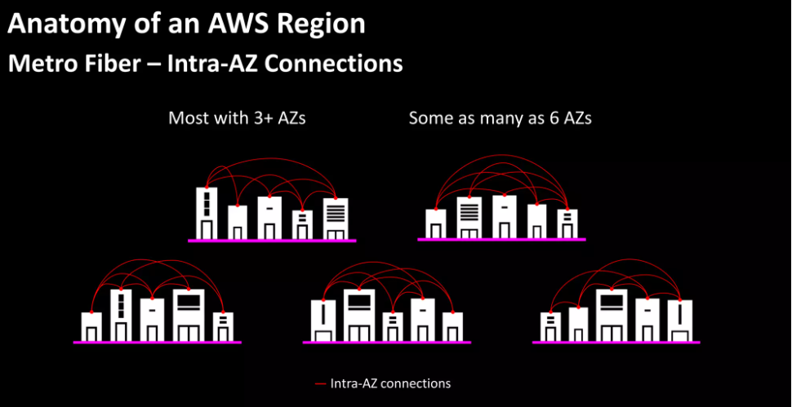

Slide 13
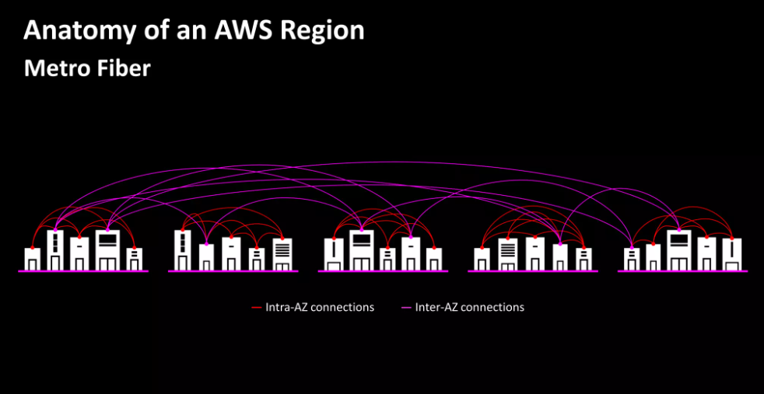

Slide 14
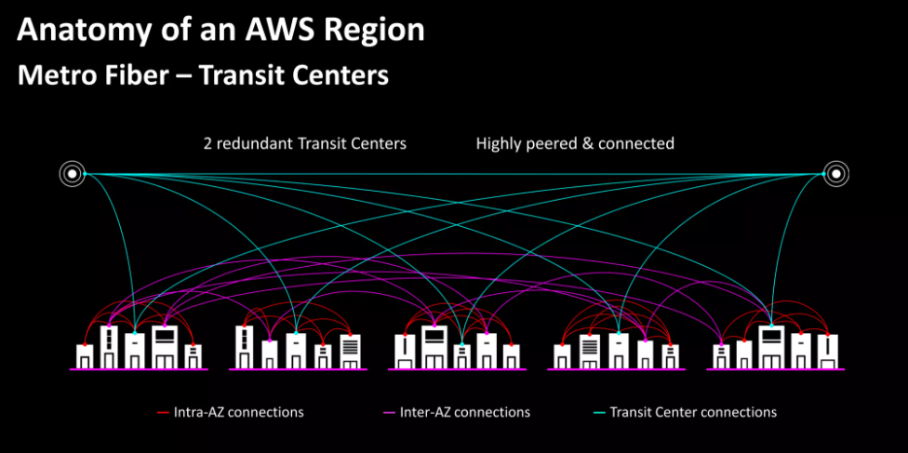

Slide 15
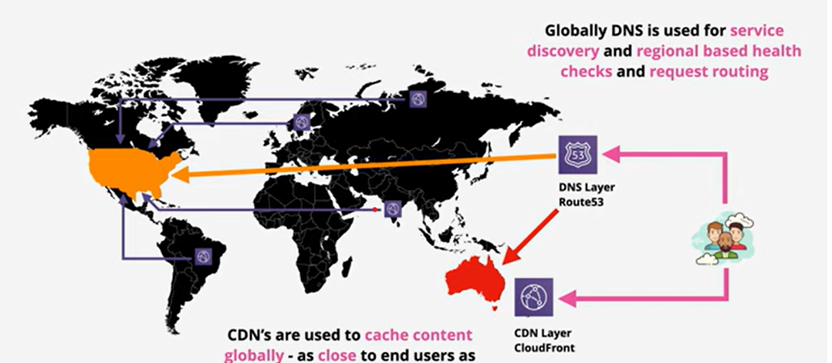

Slide 16
